Slide 1
Analysis of Impediments to Fair Housing Choice Stakeholder Informational Session May 14, 2020
City of Sherman
Presented by Civitas LLC

Slide 2
Rights to Fair Housing
Fair Housing Act (42 U.S.C. § 3601 et seq) Mandates:
to prohibit discrimination in housing-related transactions; and
to promote integrated housing patterns through a requirement that the federal government administer programs and activities in a manner that affirmatively furthers fair housing
FHA prohibits discrimination based on :
Race | Color
Religion | Sex (including gender identity)
Familial Status | National Origin
Disability

Slide 3
Fair Housing Choice
Who must comply :
New proposed Fair Housing Rule suggests that new emphasis on choice – Individuals and families have the ability to live where they choose within their economic means; without unlawful discrimination.
Protected Choice, Actual Choice, Quality Choice
Landlords Property Managers Real Estate Agents Lenders | Insurance Companies Homeowners Associations Condo boards
Discrimination includes refusing to rent to someone, steering someone away to a particular type of housing or neighborhood, enacting zoning measures to exclude particular groups etc., due to membership of a protected class.

Slide 4
Fair Housing Complaints
Example statements may indicate possible discrimination:
“You really wouldn’t have enough space with so many children”
“We have a strict policy: if you have an arrests history, you cannot rent here.”
“I don’t think your wheelchair would fit through our doors”
“You would feel more comfortable in a different neighborhood.”
Actions:
Talk to a housing counselor
You have 1 year to file a complaint with U.S. Department of Housing and Urban Development
Discrimination stops when people stop putting up with it

Slide 5
Analysis of Impediments to Fair Housing Choice
Jurisdictions directly receiving Community Development Block Grants must certify that they will Affirmatively Further Fair Housing
Review of laws, regulations, policies, and practices affecting housing affordability, accessibility, availability, and choice.
The assessment specifically includes an evaluation of:
Existing socio-economic conditions and trends in the city
Public and private organizations impacting housing issues
Barriers to fair housing choice
Actions to address any real or perceived impediments

Slide 6
Summary of Topics
Community Demographics
Economic Profile
Housing Characteristics
Public Programs and Policies
Home Mortgage Disclosure Act (HMDA) Analysis
Fair Housing Complaints and Public Input
Barriers to Fair Housing Choice
Actions to Ameliorate

Slide 7
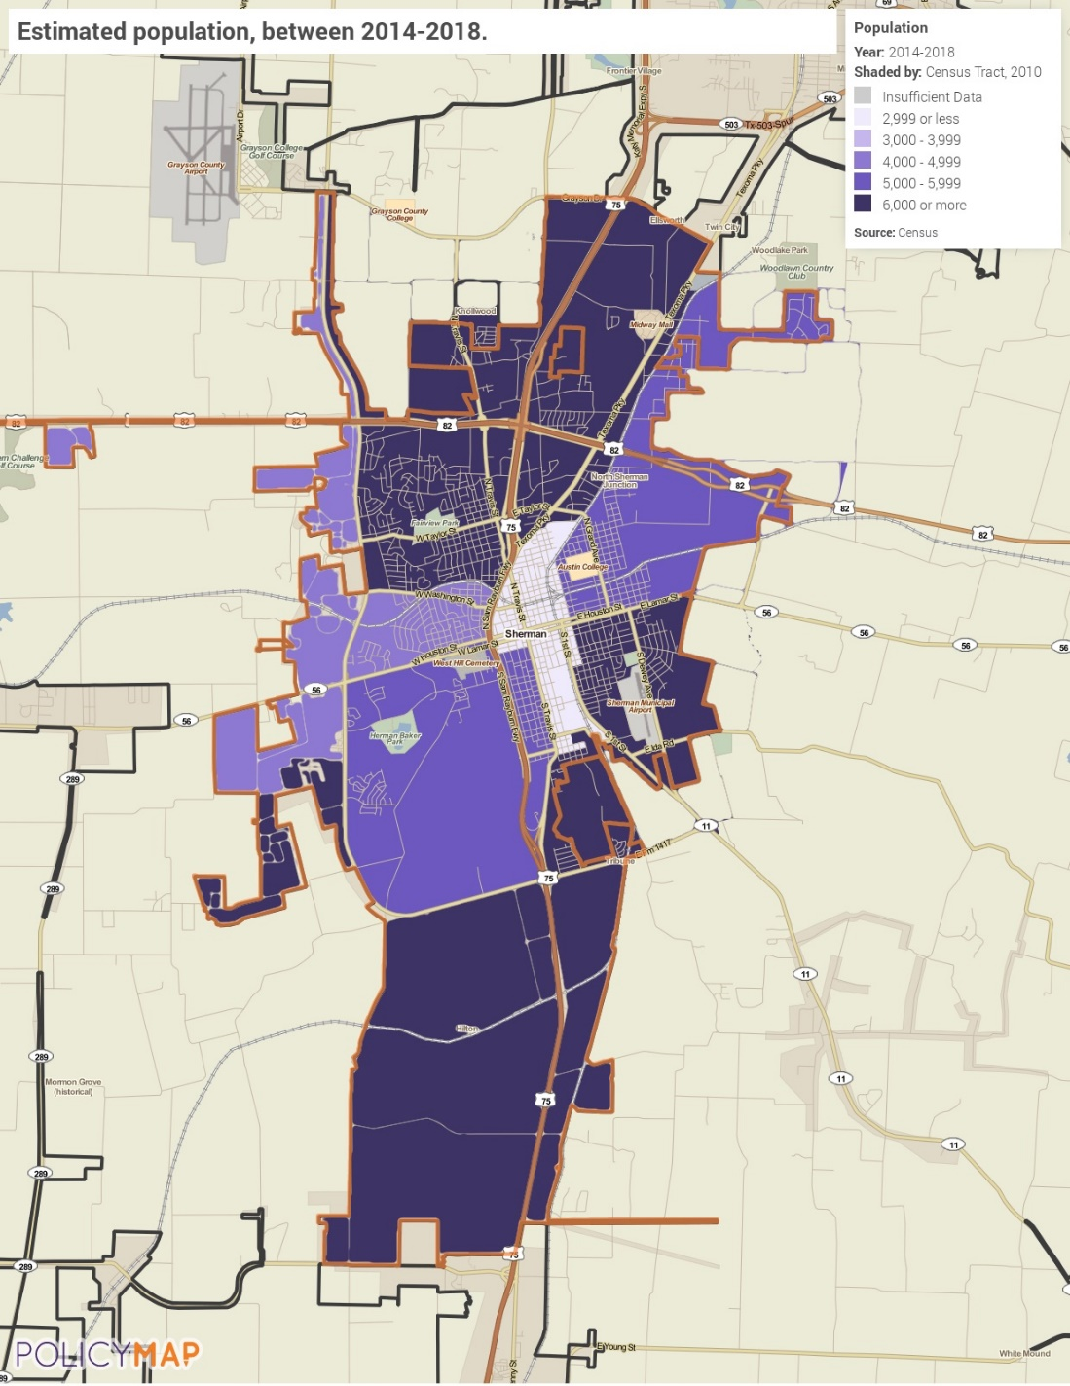
Community Profile
Population has grown by approximately 8.5% between 2010 – 2018
Central part of Sherman has the highest concentration of people
Over half of all residents 75 years and over have a disability
Demographics – 2010 to 2018
 | Base Year: 2010 | 2018 | % Change
Population | 37,943 | 41,149 | 8.4%
Median Income | $47,460 | $46,940 | -1.1%
Estimated Population
Source: 2014-2018 ACS via PolicyMap

Slide 8
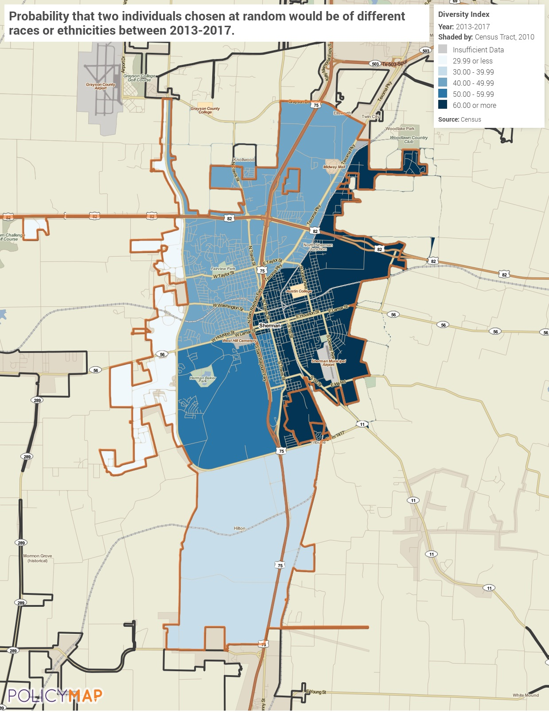
Racial Diversity Index
City of Sherman is significantly more diverse than the state
City is overall relatively heterogenous with several diverse tracts :
The downtown area is predominantly Hispanic
The second largest demographic within the City
Diversity Index Ranking
Source: 2013-2017 ACS via PolicyMap

Slide 9
Affordability
Demand for housing is outpacing supply
Median Rent Contracts have increased at a higher pace than Median Household Income
As housing costs increase in price, less housing stock available to LMI households
Fewer opportunities for LMI households to purchase home (Actual Choice)
Housing Costs: Cost Burden households in Sherman
 | Total Cost Burden
Homeowners with Mortgage | 26.9%
Homeowners without Mortgage | 10.7%
Renters | 46.6%
Source: 2014-2018 ACS

Slide 10
Citizen Participation
Citizens have a voice in addressing community needs:
Stakeholder: https://www.surveymonkey.com/r/Sherman-Stakeholder2020
Community: https://www.surveymonkey.com/r/Sherman-Community2020

