Slide 1
2020 – 2024 Consolidated Plan Informational Presentation
City of Columbia
Presented by Erich Chatham, Civitas LLC

Slide 2
Session Agenda
Consolidated Plan Process
Survey
Questions and Discussion

Slide 3
Program History & Primary Objective
The Community Development Block Grant (CDBG)
Authorized under Title I of the Housing and Community Development Act of 1974, as amended
Primary objective is the development of viable urban communities
Viable communities are achieved by providing the following,
principally for persons of low and moderate income:
Decent housing
Suitable living environment
Expanded economic opportunities
The HOME Investment Partnerships Program (HOME)
Authorized by the Cranston-Gonzalez National Affordable Housing Act of 1990
Federal block grant program to be used exclusively for affordable housing activities to benefit low-income households.
The Housing Opportunities for Persons With AIDS (HOPWA) program
Also authorized by the Cranston-Gonzalez National Affordable Housing Act
Provides housing assistance for people living with HIV/AIDS

Slide 4
Consolidated Plan Process/Requirements
Consolidated Plan
HUD entitlement grant programs are administered through the Consolidated Plan (ConPlan)
Managed through HUD’s Integrated Disbursement and Information System (IDIS) Online
Helps grantees determine activities and organizations to fund in the coming years.
Describes community needs, resources, priorities, and proposed activities to be undertaken under certain HUD program for the following five years.
Annual Action Plan
The Annual Action Plan (AP) is submitted to HUD every year during the five-year ConPlan cycle.
Describes the specific planned uses for HUD programs, and other program requirements.

Slide 5
ConPlan - Five Components
HUD 2020 Fund Allocation
1. Needs Assessment
2. Housing Market Analysis
3. 5-Year Strategic Plan
4. Annual Action Plan
5. Citizen Participation
Source | Amount
CDBG | $1,040,310
HOME | $636,992
HOPWA | $1,517,489
Total | $3,194,791 (approx.)

Slide 6
Community Development Block Grant (CDBG)
Flexible funding source that can be used for a variety of activities targeted towards low to moderate income individuals, households, and neighborhoods (80% Area Median Income and below).
Eligible uses include:
Public Improvements (Streets, Sidewalks, Parks, Sewers, etc.)
Public Facilities (Neighborhood centers, non-profit centers,
homeless facilities)
Rehabilitation of residential and
non-residential buildings
Acquisition of land or real property to be used for eligible purposes
Economic Development Activities
Public Services Including: healthcare, homeless services, literacy, youth services, senior services
Planning and Administration

Slide 7
Home Investment Partnership Program (HOME)
Funds non-profit and private developers to create affordable homes for low- and moderate-income people (under 80% of Area Median Income).
Possible projects include:
-Multi-family apartment buildings
-Housing for people with special needs (homeless, developmental disabilities etc.)
-First-time Homebuyer assistance
-Housing Rehabilitation
-Rental Assistance (vouchers)
-Capacity building for local community housing development organizations

Slide 8
Housing Opportunities for Persons With AIDS (HOPWA)
The HOPWA program provides funding to:
Housing (acquisition; rehabilitation; or new construction of housing units; rental assistance, etc)
Social services
Program planning
Development costs
An essential component in providing housing assistance for this targeted special needs population is the coordination and delivery of support services.

Slide 9
Priority Needs & Goals
Expand & Improve Public Infrastructure & Facilities | 1A Expand Public Infrastructure 1B Improve Public Infrastructure Capacity 1C Improve Access to Public Facilities
Preserve & Develop Affordable Housing | 2A Increase Homeownership Opportunities 2B Increase Affordable Rental Housing Opportunities 2C Provide Code Enforcement in LMI Neighborhoods 2D Provide Removal of Slum & Blight in Residential 2E Provide for Owner Occupied Housing Rehab
Public Services & Quality of Life Improvements | 3A Provide Supportive Services for Special Needs 3B Provide Vital Services for LMI Households
Housing & Supportive Services for Persons HIV/AIDS | 4A Provide Housing Opportunities Persons HIV/AIDS 4B Provide Medical & Support Services HIV/AIDS

Slide 10
Action Plan Projects - CDBG
Project Name | Funding
CDBG: Administration (20%) | $208,062
CDBG: Public Facilities & Infrastructure | $364,109
CDBG: Housing Programs | $312,093
CDBG: Public Services (15%) | $156,046
Total CDBG | $1,040,310

Slide 11
Action Plan Projects - HOME
Project Name | Funding
HOME: Administration (10%) | $63,699
HOME: CHDO Reserves (15%) | $95,549
HOME: Owner Occupied Rehab | $191,098
HOME: City Lender Program | $95,549
HOME: Non-CHDO Development Activities | $191,098
Total HOME | $636,992

Slide 12
Action Plan Projects - HOPWA
Project Name | Funding
HOPWA: Administration (3%) | $45,525
HOPWA: Resource ID | $5,000
HOPWA: Columbia PHA | $597,825
HOPWA: Palmetto AIDS Life Support | $329,553
HOPWA: The Cooperative Ministries | $176,371
HOPWA: Upper Savannah Care Consortium | $25,000
HOPWA: Midlands Housing Alliance Transitions | $21,390
HOPWA: USC Dept. of Medicine | $400,797
Total HOPWA (including Prior FY2019 funds) | $1,708,477

Slide 13
Citizen Participation
Community Survey | A community survey is online to obtain public input and comments for the City's ConPlan.
Stakeholder Survey | A stakeholder survey is online to obtain input from community organizations and stakeholders for input on the City's ConPlan.
30-day Public Comment Period | The City’s 2020-2024 Five-year Consolidated Plan will be made available for the public to review in April 2020. Written comments could be submitted to the City’s CDBG Administrator through email or delivered to the CDD office. Public notice will be given prior to posting.
Public Hearing | Public hearing will be held at City Council. The public hearing held is to discuss the plan as well as discussion of comments from the public. Public notice will be given prior to hearing.

Slide 14
Citizen Participation – Survey Responses
Community Survey (50 responses): | Stakeholder Survey (33 community organizations responded):
Public Improvements Sidewalks Water/Sewer & Stormwater Improvements Street Improvements Economic Development Small Business Assistance Public Transportation Job Creation & Retention Affordable Housing New Affordable Rental & Homeowner Housing Rental & Owner-Occupied Housing Rehab Energy Efficient Improvements Down Payment Assistance | Creation of affordable housing and homebuyer assistance. Public services such as employment training, crime prevention and vital services for the special needs population. Homeowner and renter housing rehabilitation. Public facilities and infrastructure improvements. Economic development
*Survey responses as of April 3, 2020

Slide 15
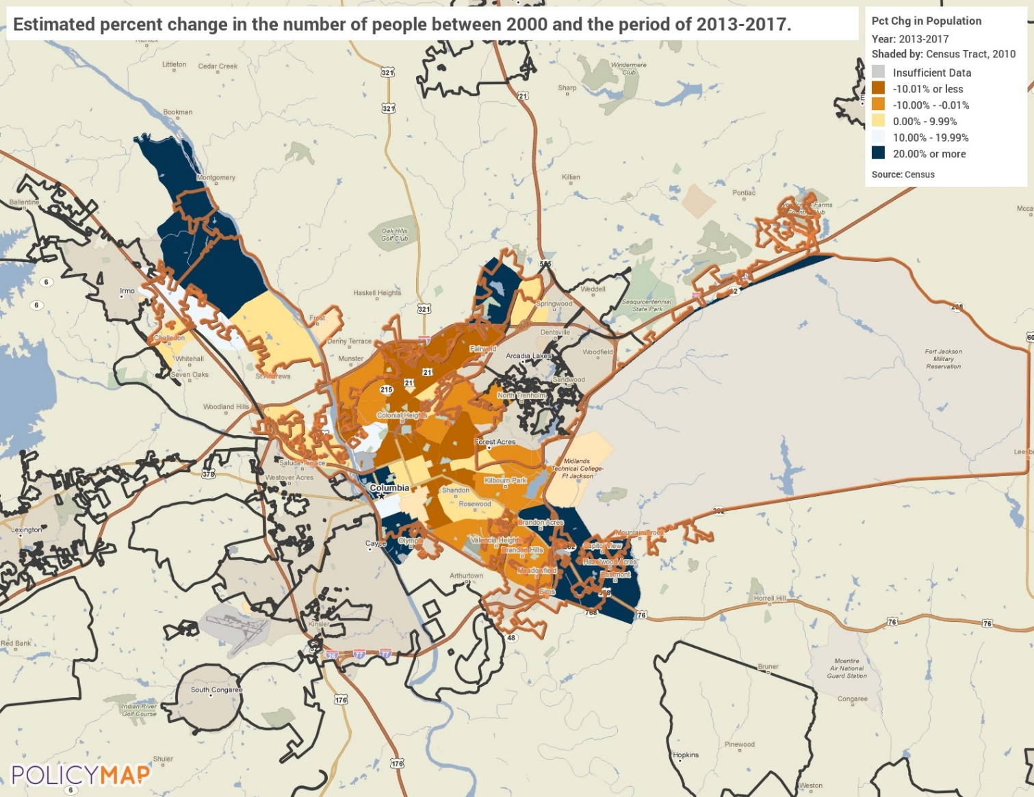
Needs Assessment – City Demographics
Table: Demographics – 2010 to 2017
 | Base Year: 2010 | 2017 | % Change
Population | 127,605 | 132,236 | 4%
Households | 46,575 | 46,098 | -1%
Median Income | $38,272 | $43,650 | 14%
Table: Population – 2010 to 2017
 | 2010 | 2017 | % Change
Columbia | 127,605 | 132,236 | 4%
State of South Carolina | 4,511,428 | 4,893,444 | 8.5%
Table: Housing Costs – 2010 to 2017
 | 2010 | 2017 | % Change
Median Home Value | $156,100 | $168,800 | 8.1%
Median Rent | $742 | $878 | 18.3%
Cost burden:
Over 55% of renters pay more than 30% of their income to housing costs.
Over 21% of homeowners are cost burden.
Population Change since 2000
Source: 2013-2017 ACS via PolicyMap

Slide 16
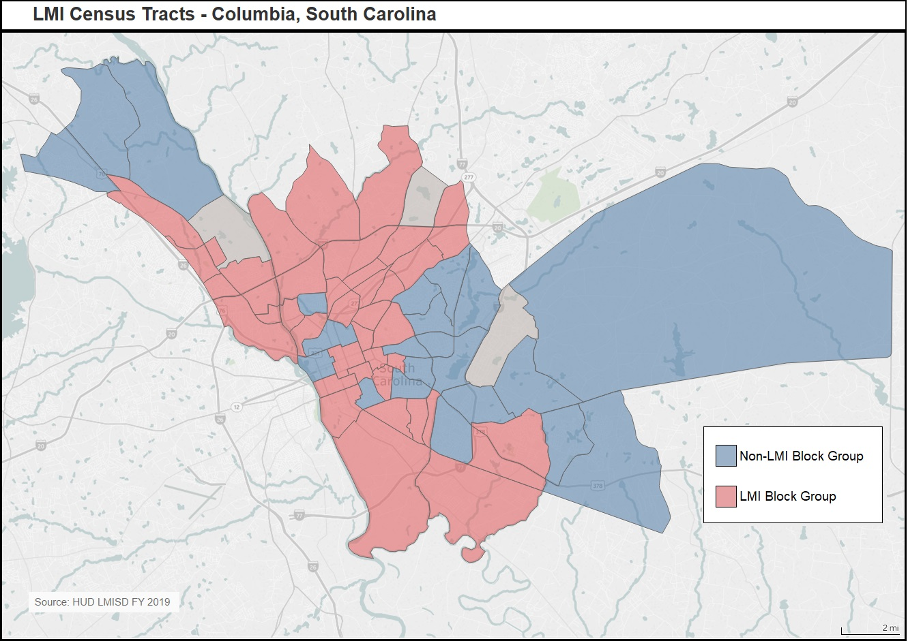
Needs Assessment – LMI Areas
Table: Poverty Rate – 2000 to 2017
 | Poverty Rate - 2000 | Poverty Rate - 2017 | Change in Poverty Rate
Columbia | 22.1% | 22.3% | +0.2%
South Carolina | 14.1% | 16.6% | +2.5%
Source: 2000 Decennial Census and 2013-2017 American Community Survey
Poverty Line for family of 4 is $25,100 (2018)
Low to Moderate Income (LMI)
LMI = Less than 80% of area median income
Columbia Median income = $43,650
LMI in Columbia = Less than $34,920 (approx.)
Low to Moderate Income Tracts
Source: HUD LMISC FY2019

Slide 17
Next Steps
Public survey (next slide)
Public comment period (April 3rd-May 3rd)
Public hearing (April 8th)
HUD submission date (May 15th)
Program year start date (July 1st)

Slide 18
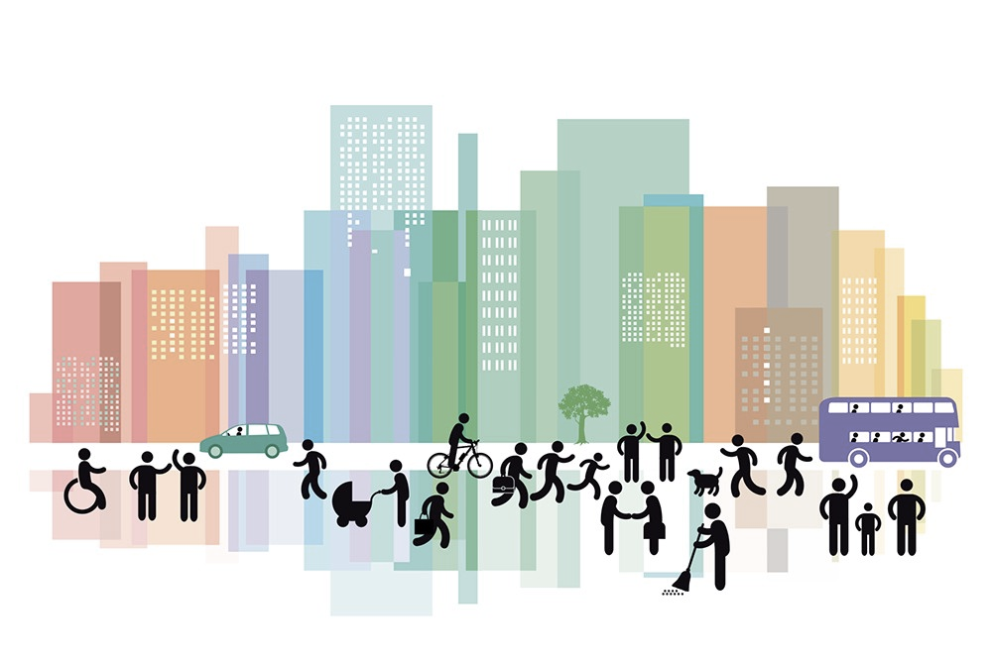
Citizen Participation
Citizens have a voice in addressing community needs:
Stakeholder: https://www.surveymonkey.com/r/ColumbiaStakeholder2020
Community: https://www.surveymonkey.com/r/Columbia_Community2020

Slide 19
Community Development Department
1401 Main Street, 4th Floor
Columbia, South Carolina 29201
Phone: (803) 545-3373
www.ColumbiaSC.gov

